Slide 1
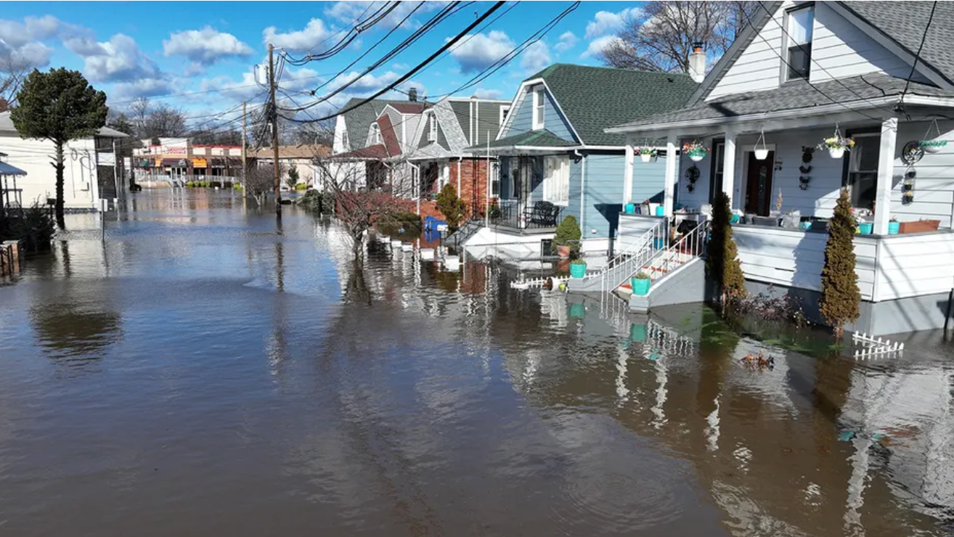
Assessing Economic Impact of Flooding in Lodi, NJ
Ivan De la Paz and Karina Magro Machado
EAES575 – Environmental Economics

Slide 2
Objective
Our objective for this project was to investigate the impact of flooding in Lodi, NJ, and ways to mitigate that impact through permeable green solutions. To do so we gathered information on the following:
River hydrology and Weather data in Lodi, New Jersey
Economic implications of flooding in Lodi, Both to residence and the Municipality
Viability and effectiveness of using permeable pavement as a long-term flood mitigation approach.
Community opinions of flooding severity and satisfaction with present mitigation initiatives.
People' willingness to invest in long-term solutions such as permeable pavement, as well as their preferred payment channels.

Slide 3
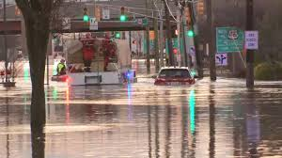
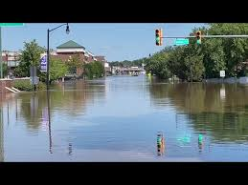
Lodi, NJ
Demographics and history
Flood Data
Lodi is a small but historically town located in Bergen County.
Lodi is now predicted to have a population of 25,969
White (Non-Hispanic): 40%
White (Hispanic): 17%
Two or More Races (Hispanic): 13.1%
Black or African American: 9.79%
Hispanic: 7.62%
Over the years Lodi has gained popularity for its difficulties with flooding
The Saddle River crested at 10.27 feet, more than 2 feet above major flood stage. This caused flooding in homes, on streets, and prompted evacuations. Some residents said it was the worst flooding they'd seen in years
Between 2019 and 2024 there were 17 floods,
5 being major flooding (over 8ft in Gage height)
3 being Modate floods ( over 7ft in Gage height)
Between 2014 and 2019 only 2 major floods happened !!In five years major flood events more than doubled!!

Slide 4
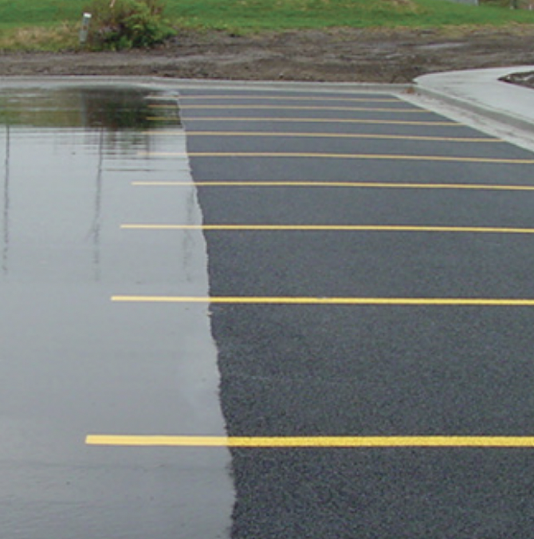
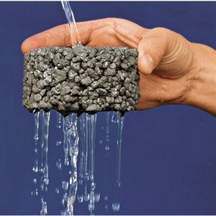
Permeable Pavement
Three types
What is it ?
In simple terms permeable pavement is a hard surface that allows rain and snowmelt to soak into the ground, instead of running off.
porous concrete.
porous asphalt.
permeable interlocking concrete paver
Benefits
Reduces runoff: Permeable pavement can reduce the volume of stormwater runoff by up to 80%. This reduces the risk of flooding and sewer backups.
Filters pollutants: The gravel layer beneath permeable pavement filters out pollutants and sediments, which improves water quality.
Recharges groundwater: Permeable pavement allows water to seep into the soil, recharging local aquifers.
Cost
The cost of installing porous asphalt typically ranges from $6 to $13 per square foot, depending on factors such as material quality, labor, and site preparation. This estimate includes both materials and installation.

Slide 5
Methodology - Calculating flooding cost and savings
2.5 miles of the Saddle river crosses through Lodi NJ
Affected Area : 27,878,400 sq ft
14 strategic locations
To cover 10% Of flood affected
Combining both removal and installation cost of PA : $8 to $16 per square foot (avg 12$)
Total Cost : $37,076,943.00 to cover 3,089,745.25 sqft
10 years of flood data
28 flood events in total
((Gage height in feet) - (Crest)) * (Affected Area))*Avg cost of flooding in Lodi ($18ft^3) = Cost to town
Cubic feet of flood water over the last 10 year = 1,025,925,120.00 cubic feet
or 6,714,679,910.40 cubic gallons
Cost to town over the last 10 year : $18,371,865,600
Porous asphalt can infiltrate approximately 75% of rainfall (cubit feet)
Affected Area cover by PA * 75% = infiltrated water = 85,276,968.90
Potentially saving the town in 10 years = 1,534,985,440.20
which covers the cost of installation and maintenance twice over !

Slide 6
Methodology - Survey
Sections
Survey Tools and Distribution
Demographics
Age, income, residency period, and housing status.
Flooding Impact
Experiences over the past 5 years: property damage, insurance claims, expenses.
Frequency, severity of events, and satisfaction with current mitigation efforts.
Permeable Pavement
Awareness, support, and investment willingness.
Preferences for funding mechanisms and additional information needs.
Tool Used
Qualtrics
Distribution Methods
In-person: door to door
Ethical Considerations
Participation was voluntary and anonymous
Informed Consent
Explained study goals and participant rights.
Ensured no personal data collection.

Slide 7
Results - Willingness to Pay
51.85% of the houses are willing to pay to install permeable pavement. 14.81% are not willing to pay and 33.32% are unsure.
Most people want to pay as voluntarily contributions (56%).
Most houses are willing to pay up to $100 annually (78.26%).
Most houses wanted to see the cost-benefit analysis or success stories from other towns in order to make a definite decision (91%).
21.82% of the higher income house are willing to pay.
68.75% of people who have experienced flooding in the past 5 years are willing to pay for permeable pavement.
People who have experienced flooding are approximately 55.56% more likely to be willing to pay for permeable pavement compared to those who have not experienced flooding.
On average, households are willing to pay approximately $78.26 annually for permeable pavement.

Slide 8
References
Arora, M., Chopra, I., Nguyen, M.H., Fernando, P., Burns, M.J. & Fletcher, T.D. (2023). Flood Mitigation Performance of Permeable Pavements in an Urbanised Catchment in Melbourne, Australia (Elizabeth Street Catchment): Case Study. Water, 15, 562. https:// doi.org/10.3390/w15030562
Lodi Memorial Library. (n.d.). History of Lodi. https://www.lodilibrarynj.org/historical-photos-of-lodi.html
Singer, M.N.; Hamouda, M.A.; El-Hassan, H.; Hinge, G. (2022). Permeable Pavement Systems for Effective Management of Stormwater Quantity and Quality: A Bibliometric Analysis and Highlights of Recent Advancements. Sustainability, 14,13061. https://doi.org/10.3390/ su142013061
U.S. Census Bureau. (2023). U.S. Census Bureau quickfacts: United States. https://www.census.gov/quickfacts/fact/table/us/pst045219
Zhang, Z., Sha, A., Liu, X., Luan, B., Gao, J., Jiang, W., & Ma, F. (2020). State-of-the-art of porous asphalt pavement: Experience and considerations of mixture design. Construction and Building Materials, 262, 119998. https://doi.org/10.1016/j.conbuildmat.2020.119998

Slide 9
Thank you!

